Slide 1

Geometry
Unit 5, Lesson 8 The Proof Is in the Bag! Volume 1, pg. 267

Slide 2


Benchmarks
MA.912.GR.1.2 Prove triangle congruence or similarity using Side-Side-Side, Side-Angle-Side, Angle-Side-Angle, Angle-Angle-Side, Angle-Angle, and Hypotenuse-Leg.
MA.912.GR.1.6 Solve mathematical and real-world problems involving congruence or similarity in two-dimensional figures.
MA.912.LT.4.10 Judge the validity of arguments and give counterexamples to disprove statements.
volume 1, pg. 267

Slide 3
Integrated Mathematical Thinking and Reasoning Standards
MA.K12.MTR.1.1 Actively participate in effortful learning both individually and collectively.
MA.K12.MTR.3.1 Complete tasks with mathematical fluency.
MA.K12.MTR.4.1 Engage in discussions that reflect on the mathematical thinking of self and others.
MA.K12.MTR.5.1 Use patterns and structure to help understand and connect mathematical concepts.
volume 1, pg. 267

Slide 4

Learning Targets
I can prove two triangles are congruent using SSS, SAS, ASA, AAS, or HL congruence.
I can prove parts of triangles are congruent using triangle congruence and corresponding parts of congruent triangles.
volume 1, pg. 267

Slide 5

Warm-Up
volume 1, pg. 268

Slide 6
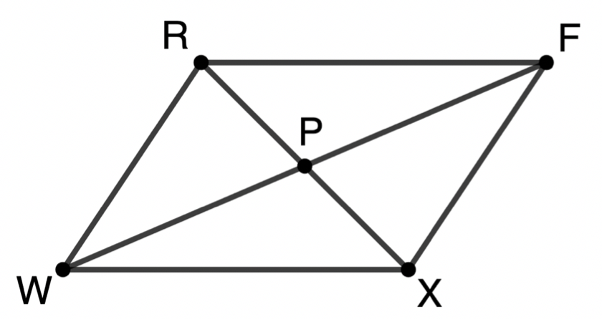
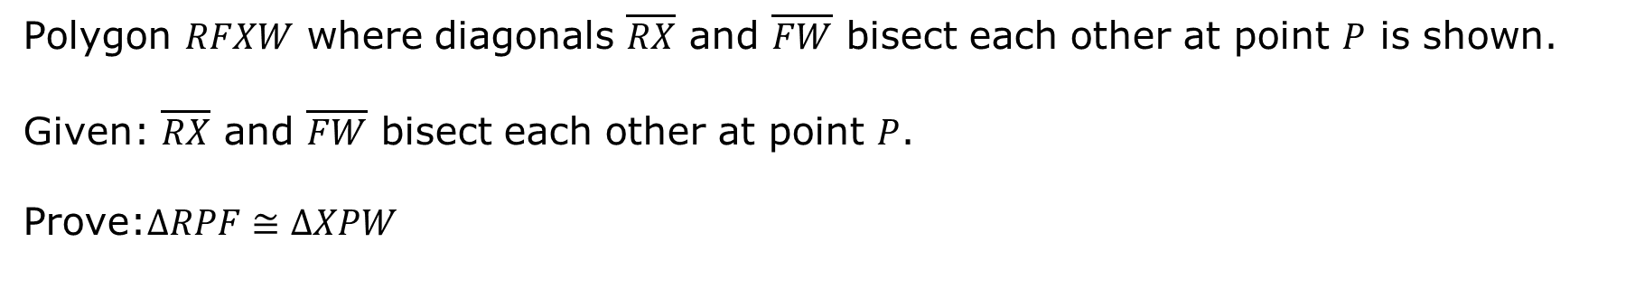
5.8.1 Warm-Up: Bell Work
Polygon $RFXW$ where diagonals $\overline{RX}$ and $\overline{FW}$ bisect each other at point $P$ is shown.
Given: $\overline{RX}$ and $\overline{FW}$ bisect each other at point $P$.
Prove:$∆RPF≅∆XPW$
volume 1, pg. 268

Slide 7
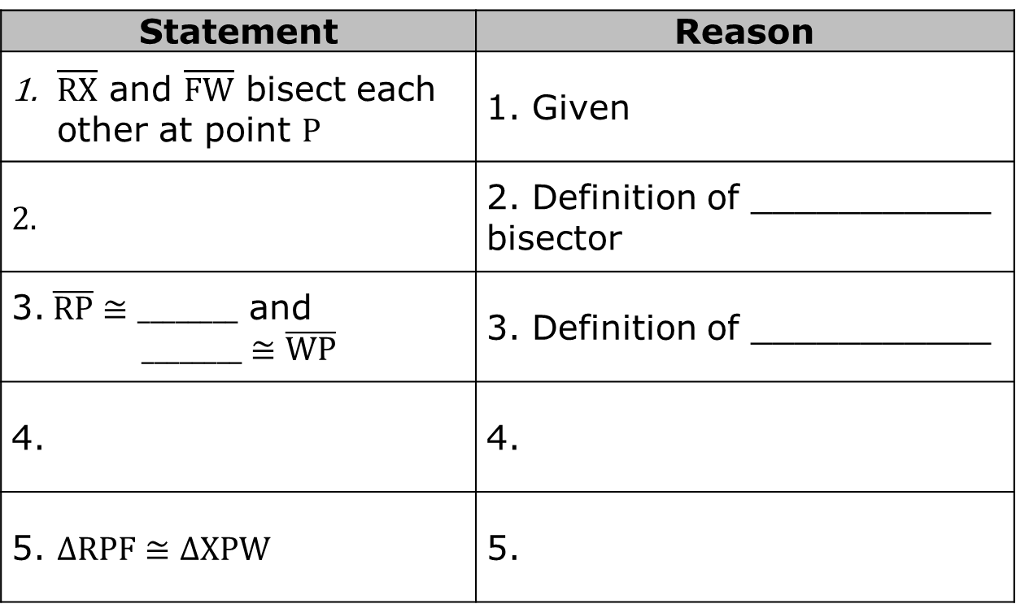
Complete the two-column proof.
Statement | Reason
$\overline{RX}$ and $\overline{FW}$ bisect each other at point $P$ | 1. Given
 | 2. Definition of ___________ bisector
3. $\overline{RP}≅________$ and $$________≅\overline{WP}$$ | 3. Definition of ___________
4. | 4.
5. $∆RPF≅∆XPW$ | 5.
volume 1, pg. 268

Slide 8

Activity
volume 1, pg. 268

Slide 9

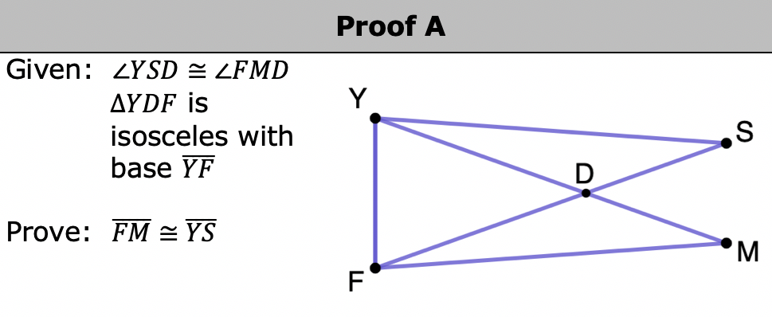
5.8.2 Activity: It’s in the Bag!
With your group, complete each proof using the statement and reason cards provided.
volume 1, pg. 268

Slide 10
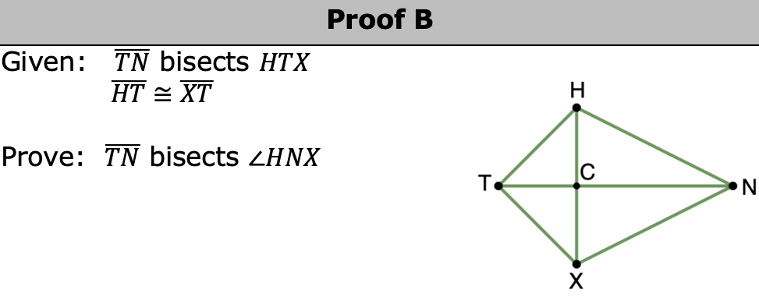
volume 1, pg. 269

Slide 11
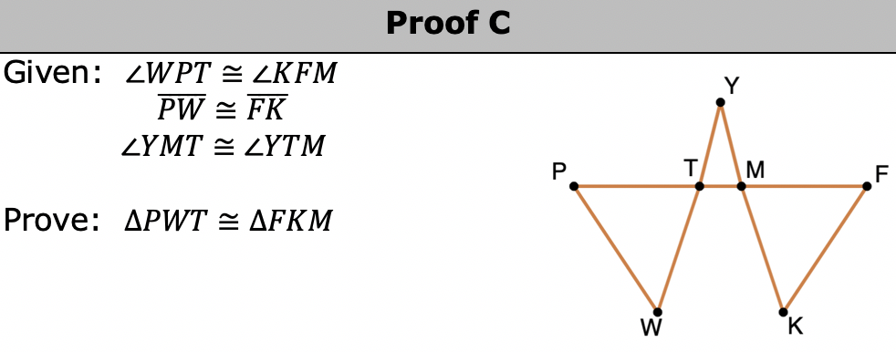
volume 1, pg. 269

Slide 12
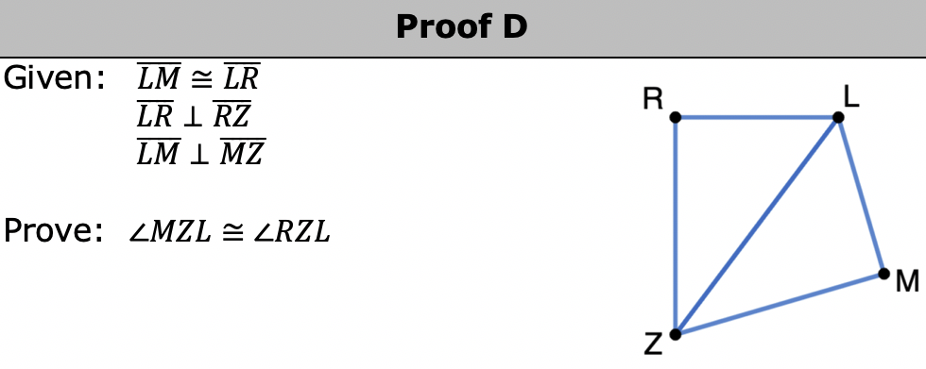
volume 1, pg. 270

Slide 13
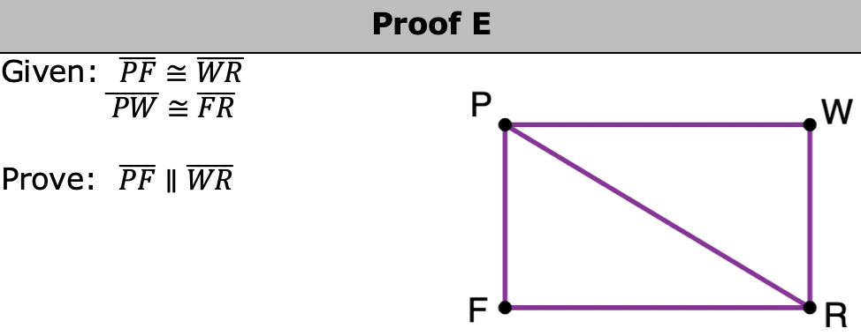
volume 1, pg. 270

Slide 14
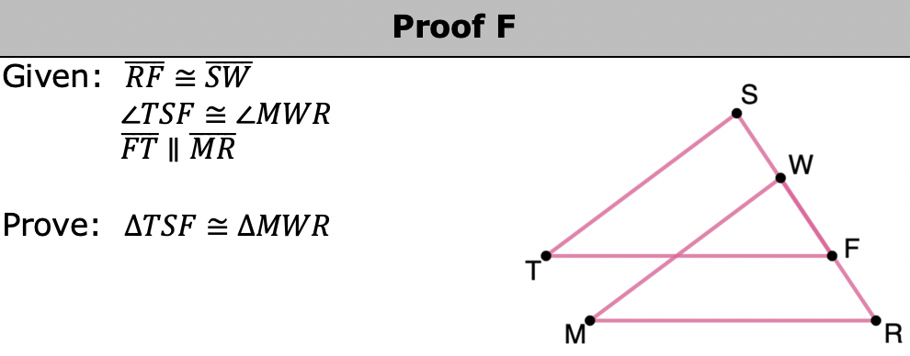
volume 1, pg. 271

Slide 15

Wrap-Up
volume 1, pg. 271

Slide 16
5.8.3 Wrap-Up: Cool Down
Write an explanation to a classmate who might have missed today’s lesson, in your own words, about writing proofs.
volume 1, pg. 271

